Slide 1
Week 10:
Dependency, Coupling and Cohesiveness
Button/Lamp demo
Array Lists
Let’s build our own ArrayList
Generics
Hashmaps

Slide 2
Dependency
If you have a job that pays you money every week, you have a dependency on that company.
If something happens to the company, it impacts you.
If something happens to you, it impacts the company.
If you are a carpenter, you are dependent on your hammer. Is your hammer dependent on you?

Slide 3
Let me ask you…
Do you remember (in your brain) where to find every PayPhone in the world?
Do you like to know where your CellPhone is at all times?
Is it very important to you to know where your Heart is at all times?
Are you willing to loan your CellPhone to a friend?
Are you willing to loan your Heart to a friend?

Slide 4
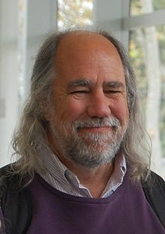
Hmm…There is a lot of disagreement about this…
We use a PayPhone (but we don’t keep its address)
Dependency
We use/own a CellPhone and always want to know where it is but we are willing to share it or give it away.
Aggregation.
We own a Heart and it lives and dies with us.
Composition
Association
Grady Booch

Slide 5
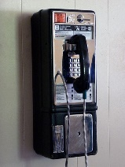
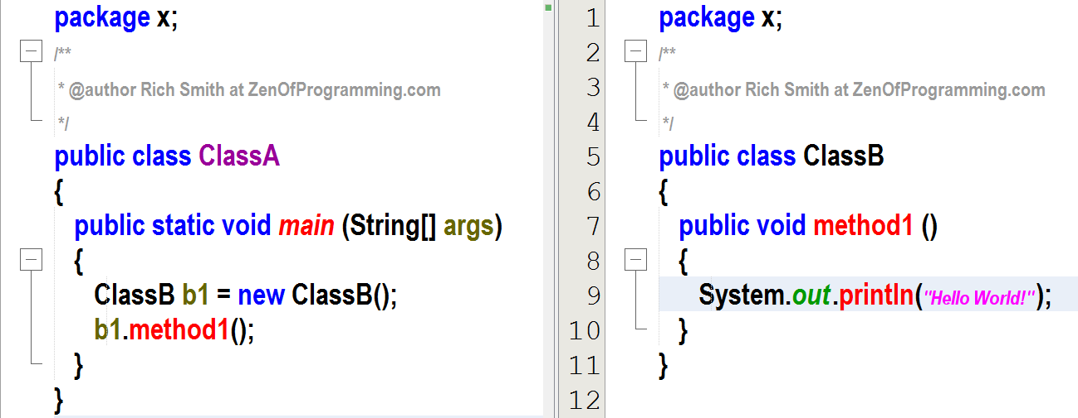
Dependency
Whenever a class A uses another class (or interface) B, then A depends on B.
A cannot carry out it's work without B, and A cannot be reused without also reusing B.
In such a situation the class A is called the "dependant" and the class or interface B is called the "dependency".
When there is a dependency between classes, you have coupling. Every program needs some coupling or it would do nothing.
However, we want to make our classes as loosely coupled as possible.
ClassA
ClassB
…
…
ClassA is dependent on ClassB
ClassB is not dependent on ClassA

Slide 6
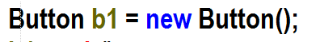
What does this really do?
Declares a reference variable called b1 of type Button
Instantiates a Button Object from the Button Class
Runs the Button Constructor
Returns the address of the Button Object (which is in the heap somewhere) to the reference variable b1.
b1 now holds the address of the Button Object
Sometimes, we say that b1 is the object for simplicity. (However, always remember that b1 actually holds the address of the object, not the object itself)

Slide 7
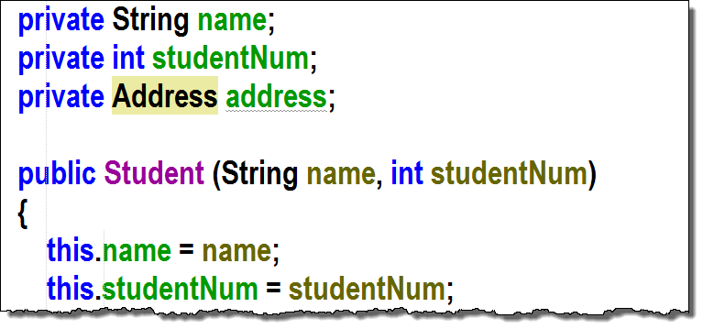
‘Holds a Reference’
When an object has an instance variable that is a reference variable (holds the address of another object), we say that the object ‘holds a reference’ to the other object

Slide 8

Association
Association is a more strongly coupled relationship than dependency.
One test for Association:
Does ObjectA ‘hold a reference to’ (has an instance variable that holds its address) ObjectB.
Another way to say it is ObjectA holds a class-level reference to ObjectB
For plain old association, there is no implied ownership between the objects. One object does not own the other object.

Slide 9
Association
It turns out that there can be two kinds of association that have even more tight coupling between objects:
Aggregation
Composition
Remember, the test for association is that one object holds a reference to another object.

Slide 10

Aggregation
Two tests for aggregation:
Does ObjectA hold a reference to ObjectB? (Association)
Does ObjectA have an implied ownership of ObjectB? (CellPhone)
However, ObjectA can exist without ObjectB and ObjectB can exist without ObjectA.
Note, for all practical purposes, we don’t need to distinguish between association and aggregation. They are identical in terms of code and the difference is just semantics around ownership.
In any quiz or exam, we can equate Association and Aggregation
We also sometimes refer to aggregation as weak association

Slide 11


Composition
Three tests for composition:
Does ObjectA hold a reference to ObjectB? (Association)
Does ObjectA own ObjectB? (Another way to say this: is ObjectA composed of ObjectB?)
Are ObjectA and ObjectB born together and do they die together?
We sometimes refer to Composition as Strong Association

Slide 12
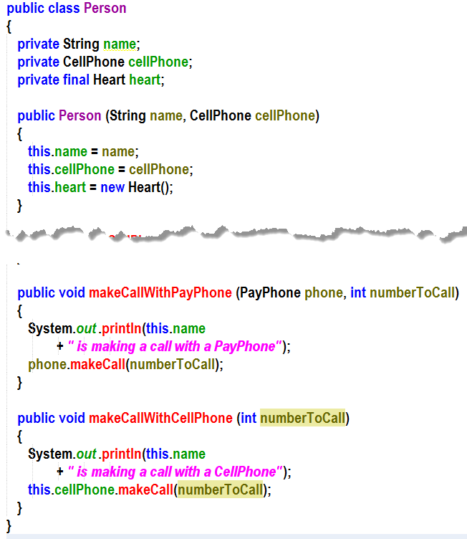
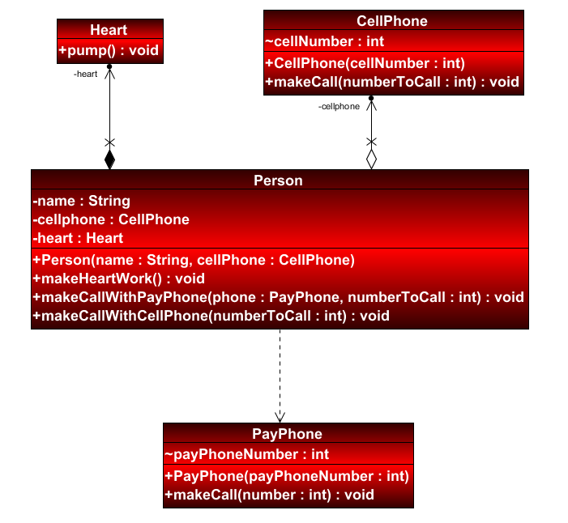
Relationships
Composition
Aggregation
Dependency
Demo 3

Slide 13

Relationships
Less coupled
Dependency
Uses but doesn’t hold a reference to
Association
Holds a reference to but no ownership
Aggregation
more coupled
Holds a reference to and implied ownership
Composition
Holds a reference to and live and die together

Slide 14
This is a really good paper on all of this
Association vs. Dependency vs. Aggregation vs. Composition – Niraj Bhatt – Architect's Blog (wordpress.com)

Slide 15
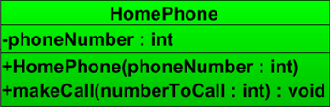
YourTurn1 (part a): HomePhone
prints
HomePhone is dialing 5685844

Slide 16
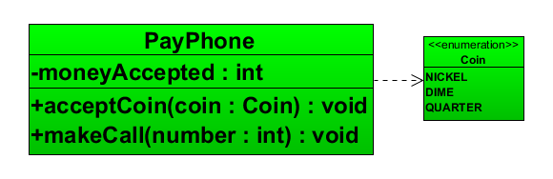

YourTurn1 (part b): PayPhone
A PayPhone can accept either nickels (5 cents), dimes (10 cents), or quarters (25 cents)
Can make calls (accepts the number to call) if at least 25 cents have been deposited into it)
PayPhone is dialing 5685844
OR Sorry, not enough change inserted

Slide 17
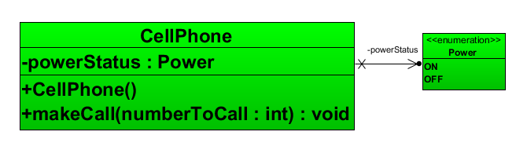
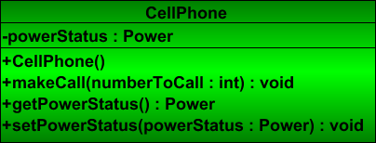

YourTurn1 (part c): CellPhone
CellPhones can’t make a call unless their powerStatus is ON
CellPhones should be turned off when they are first instantiated
CellPhone is dialing 5685844
OR Sorry, CellPhone power is turned off

Slide 18
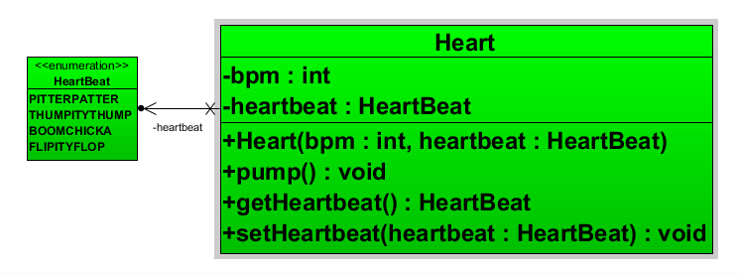

YourTurn1 (part d): Heart
pump will print the heartbeat out as many times as bpm is set to
PITTERPATTER..PITTERPATTER..PITTERPATTER

Slide 19
Yourturn1 (part e)
Write a Start Class to test all of your Classes
Add the code to make an array of 3 hearts (use the shortcut method) and have each heart pump for one minute
Draw the memory of the jvm at the point immediately after the array was created.

Slide 20
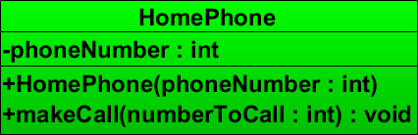
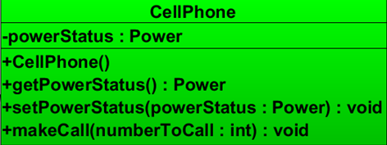
54
pitterpatter
Let’s look at it with the debugger!
hearts [0]
@
All bytecode needed for Start Class and Heart, PayPhone, HomePhone, and CellPhone objects
hearts [1]
@
hearts [2]
@
66
boomchicka
54
thumpthump
5434567
cellPhone=@
homePhone=@
payPhone=@
55
thumpity
ON
hearts =@
h1 =@

Slide 21
Dependency Review
When a class can’t compile without the other class but does not ‘hold a class-level reference to the other object’
Can have one-way dependency or two-way dependency

Slide 22
Association (Aggregation) Review
When a class can’t compile without the other class AND ‘holds a class-level reference to the other object’

Slide 23
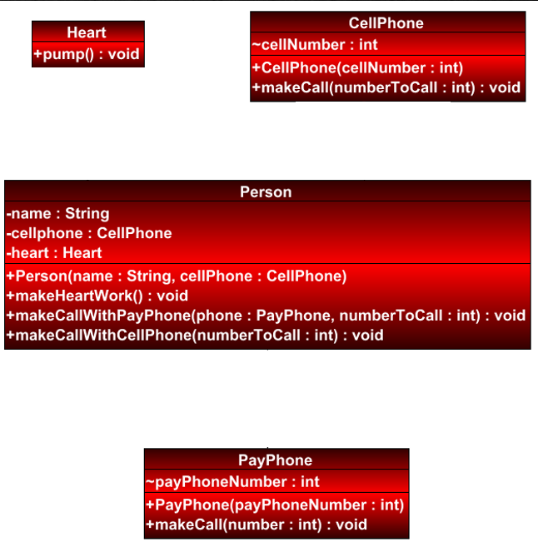
Association Review
When a class can’t compile without the other class AND ‘holds a class-level reference to the other object’
Composition
Aggregation
Dependency

Slide 24
Composition Review
When a class can’t compile without the other class AND ‘holds a class-level reference to the other object’
AND both objects are born together and die together
Composition
Aggregation
Dependency

Slide 25
Dependency /Association / Aggregation / Composition
Dependency
Any object that uses another object by instantiating an object locally in a method or by accepting an object reference in a method parameter
Association
One object holds a reference to another object but there is no ownership to the relationship
Aggregation
An object holds a reference to another object but both objects can exist independently. One object has some implied ownership of the other (semantically) but both objects have independent lifespans.
The owned object is created outside of the owner object and passed in
Composition
Same as aggregation except that one of the objects can’t exist without the other one. ObjectB is completely owned by ObjectA until DEATH!
Both objects are born (instantiated) at the same time and both die at the same time.
https://vaughnvernon.co/?page_id=31

Slide 26
Here’s where polymorphism becomes interesting
Week-10-buttonandlamp: Start –PART A

Slide 27
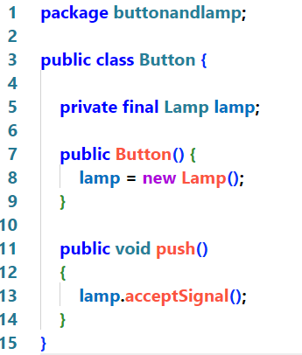
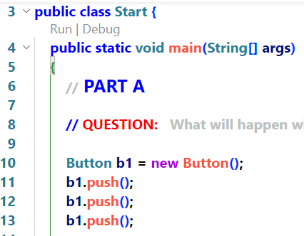
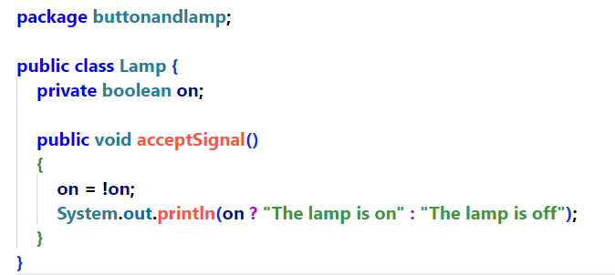
Part A Discussion

Slide 28

Tightly Coupled
Button1
Lightbulb1

Slide 29
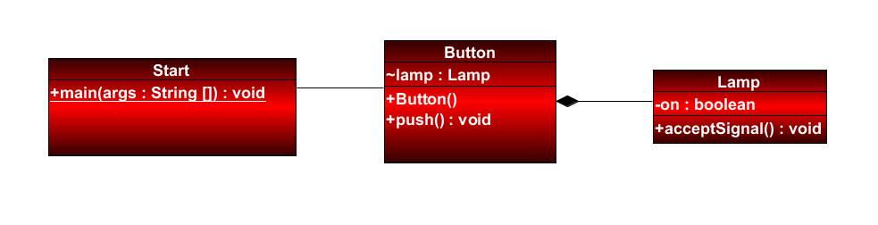
UML Diagram
Composition

Slide 30
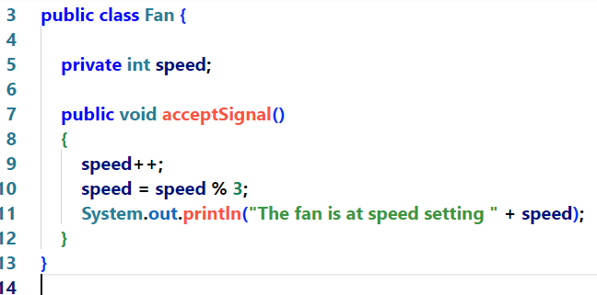
But now I want to control a Fan
Uh Oh!!! So much code to rewrite! And now Button won’t work with Lamp anymore!

Slide 31
Let’s loosen up the coupling between Button and Lamp
Week-10-buttonandlamp: Start –PART B

Slide 32
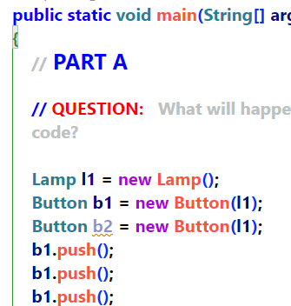
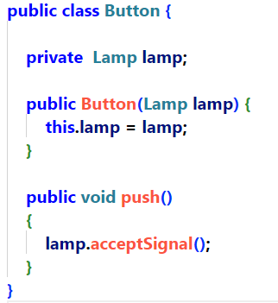
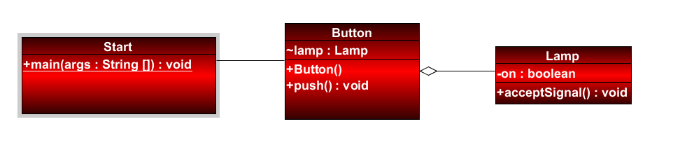
Part B Discussion
Lamp is no longer final. If we wanted to at a setLamp, we could even swap out different lamps to be operated by button
Notice that Lamp l1 exists independently of Button b1
If b1 is destroyed, l1 still continues to exist
Notice, also, that we can pass the same l1 Lamp to two different buttons.
This is no longer a composition relationship. It is association/aggregation.

Slide 33
Still Tightly Coupled (But slightly looser)
Button
Lamp
Button and Lamp are tied together, but not for life!
However, we still can’t operate a Fan without major re-write to the Button class!
Our code is less-tightly coupled but still more tightly coupled than we would like

Slide 34
Polymorphism Fixes everything!
Week-10-buttonandlamp: Start –PART C

Slide 35
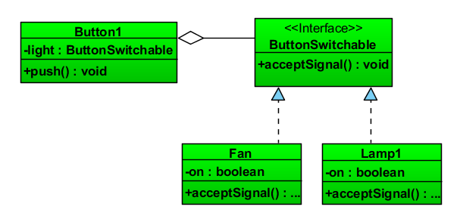
A Better Way…

Slide 36
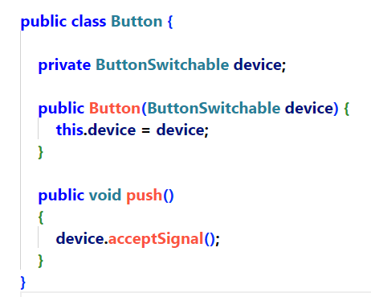
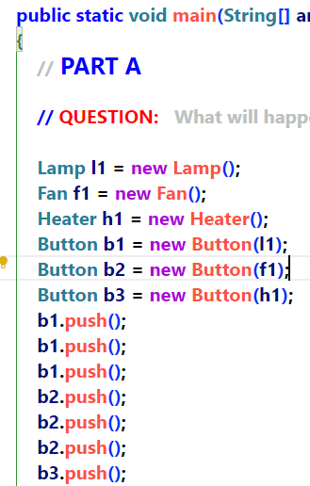
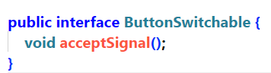
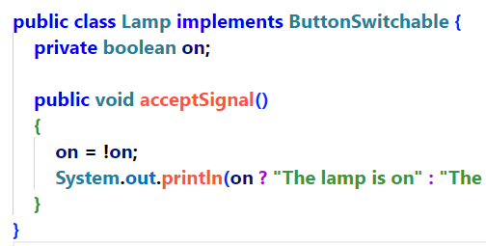
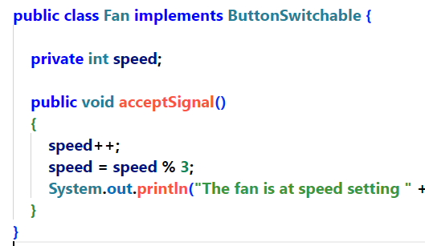

Slide 37

Loosely Coupled
Button1
Polymorphic
Interface
holds a reference to
Implements
Implements
Implements
LightBulb1
Fan
Heater

Slide 38
Module-10-yourturn2:Start

Slide 39

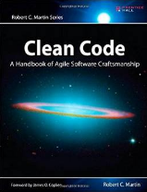
Advertisement
When there is a dependency between classes, you have coupling. Every program needs some coupling or it would do nothing.
However, the more tightly-coupled a program is, the harder it will be to maintain and the less we will be able to re-use classes in other projects.
We want to make our classes as loosely-coupled as possible.
Robert C Martin (Uncle Bob) SOLID Principles
Our Button demo is an example of the D is SOLID – Dependency Inversion Principle

Slide 40
This is just the tip of the iceburg…
Clean Code is a complete discipline…
It includes a set of principles, a bunch of design patterns and a whole lot of arguments.
It is like chess…
It is the difference between a coder and a software architect..

Slide 41
An advertisement for TDD
Test-driven development is discipline that involves the programmer writing failing ‘unit tests’ and then writing their code to make the tests pass.
It is a very powerful way to build large projects and knowing TDD will make you much more sought after in the job market
TDD could be a course in and of itself, and is beyond the scope of this course but, something to keep in mind, using Dependency Inversion and other Solid principles makes TDD much easier.

Slide 42
Further Resources
https://www.youtube.com/watch?v=t86v3N4OshQ – uncle bob video
http://www.amazon.ca/Robert-Martin-Clean-Code-Collection-ebook/dp/B00666M59G/ref=sr_1_3?ie=UTF8&qid=1426068908&sr=8-3&keywords=clean+code –uncle bob’s books
http://www.planetgeek.ch/wp-content/uploads/2013/06/Clean-Code-V2.1.pdf - Clean code cheat sheet

Slide 43
ArrayList
OK, so what is something that bugs you about arrays?
We have to know how big to make an array while we are writing the code!
Wouldn’t it be nice if it just got bigger as we needed?
ArrayList to the rescue!

Slide 44
ArrayLists
Week-09-arraylist:Start

Slide 45
Your Turn 3

Slide 46
What’s the deal with the < > brackets
First, wouldn’t it be cool to create a Class called O so that we could make a tie fighter in our code?
The < > contains what is known as a generic.
We will learn more about generics soon but, for now, think about it as a way to tell ArrayList what type of objects we want to store in it.
ArrayList <String> will store Strings
ArrayList <Person> will store Person objects
ArrayList <Integer> will store ints (wrapped in an Integer class)
ArrayList
<O>
The force is strong with this one…

Slide 47
Making our Classes accept Generics
makingourowngenerics

Slide 48
Yourturn 4

Slide 49
Yourturn 4
Let’s do Yourturn4 together!

Slide 50
Everything is a tradeoff
 | Arrays | ArrayList
Sizing | Need to know the size while writing the code | The ArrayList will grow as needed during runtime
Accessing an element | Fast (Big O = 1) | Fast (Big O = 1)
Adding an element | Fast (Big O = 1) | Can be slow and unpredictable Big O > 1
Finding an element | Big O = n | Can be faster depending on implementation
Removing an element | Need to write a lot of code | easy
Generics | Supported but awkward | easier
Other functionality | Not much | Richer (contains, find, etc)

Slide 51
Let’s build our own CoolArrayList!
Week-10-coolarraylist.Start

Slide 52
OK, we solved the downside of needing to know the size of our list at design time
QUESTION: What is one disadvantage of ArrayList has compared to Arrays?
ANSWER: =>
When we are adding items to our list the time it takes is not predictable
It could be instant or it could be n where n is the size of the list

Slide 53
Let’s rebuild our own CoolArrayList WITH GENERICS!
Week-10-coolarraylist.Start

Slide 54
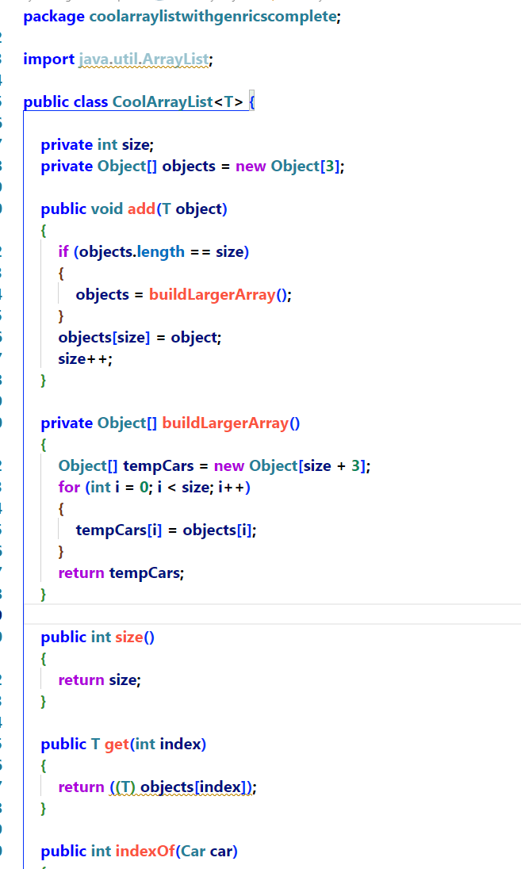
Since we never know what type might be passed in by the calling method, holding everything in Object seems to be a good strategy. (Remember, every class inherits from Object so an object reference variable can contain the address of any type of object imaginable)
First, we tell the class to expect a type in <> when the class is instantiated
Now, we can use that <T> to substitute for types where we need to in the code.
If we have taken an object and stored it with a reference variable of type Object, the compiler can only see methods that were written in the Object class. To make use of the object as it was passed in, we must cast it back to its original type.

Slide 55
Your Turn 5 – a & b

Slide 56
Yourturn 5
Let’s do Yourturn5 together!

Slide 57
Generics – We have just scratched the surface
What you have learned about Generics, so far, will serve you well 90% of the time that you need to use them.
There are more advanced things to consider such as Bounded Generics, Wildcards etc but they are beyond the scope of this course and rarely needed.

Slide 58
Just a reminder
None of this stuff would be possible without polymorphism!

Slide 59
HashMaps
Week-09-hashmap:Start

Slide 60
HashMaps
Allow us to create key->Value pairs
Allow us to retrieve the value using the key.
Do other things if you are willing to watch some videos!

Slide 61
How hash maps work is very interesting
Bad news is that we don’t have time to look into it in this course.
The good news is you won’t have to know how it works on the exam.
The better news is that youtube has a whole bunch of videos that show how it works internally! It is pretty cool – honest!

